Slide 1
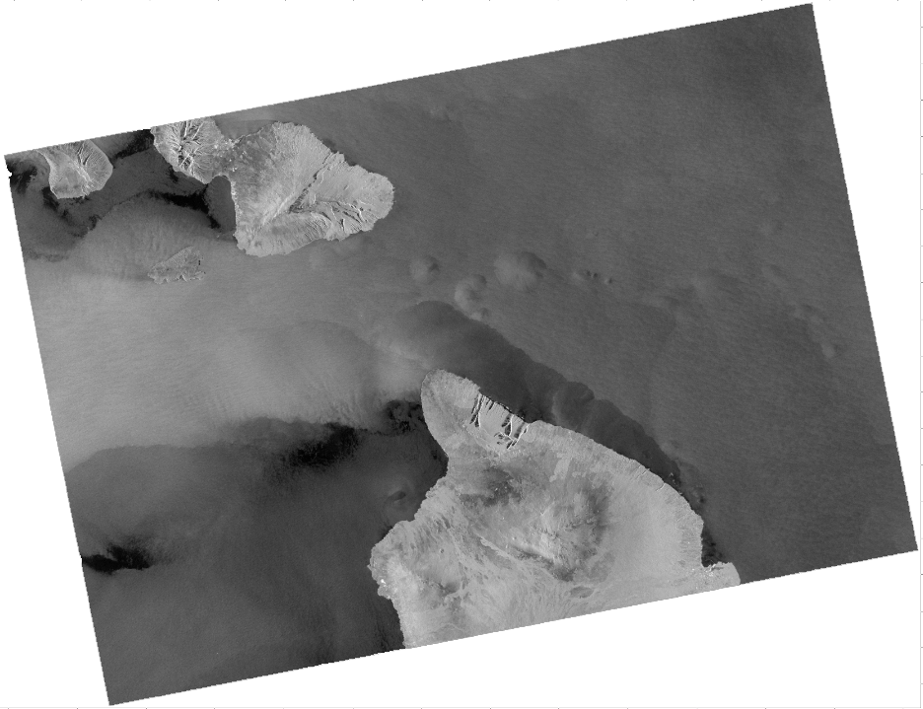

How Various Oceanic and Atmospheric Phenomena Appear in SAR Imagery
Module 3: Synthetic Aperture Radar Series
NOAA CoastWatch Satellite Courses
Sentinel-1 SAR image Hawaii 29 May 2022 04:31 UTC
Last Updated: 12/10/2024
coastwatch.info@noaa.gov

Slide 2
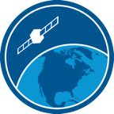
The CoastWatch Synthetic Aperture Radar instructional series
The CoastWatch Synthetic Aperture Radar (SAR) instructional series consists of three (3) training modules:
Module 1: An overview of SAR
Module 2: Descriptions of available SAR products and where to find them
Module 3: Examples of how various phenomena appear in SAR imagery (this module)

Slide 3
What can be detected by SAR?
Oceanic
Surface Waves
Significant Wave Height
Wave Spectra
Surfactants (Biogenic Slicks,
Oil Seeps)
Sea Ice
Internal Waves
Currents and Fronts
Eddies
Upwelling
Underwater Topography
Atmospheric
Surface Wind
Convection Cells / Rolls
Storm Systems
Vortex Streets
Gravity Waves
Rain Cells / Thunderstorms
Anthropogenic
Hard Targets (Ships/Oil Platforms)
Ship Wakes
Pollution (Oil Spills)
Coastal / Land
Flooding and Inundation
Shorelines
Land Use
Land Deformation (interferometry)
Burn Scar Identification
…there are many other applications

Slide 4
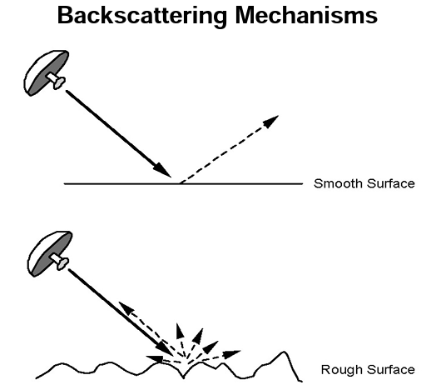
A radar measures the portion of the transmitter radar energy that is backscattered to the antenna
Smooth surfaces scatter most of the radar energy away from the radar, so less signal is backscattered to the SAR antenna.
These SAR images appear black.
Rough surfaces backscatter more the radar energy back to the SAR antenna.
These SAR images appear brighter
Normalized Radar Cross Section (NRCS) is the measure of radar backscatter
Images from https://appliedsciences.nasa.gov/join-mission/training/english/arset-introduction-synthetic-aperture-radar

Slide 5
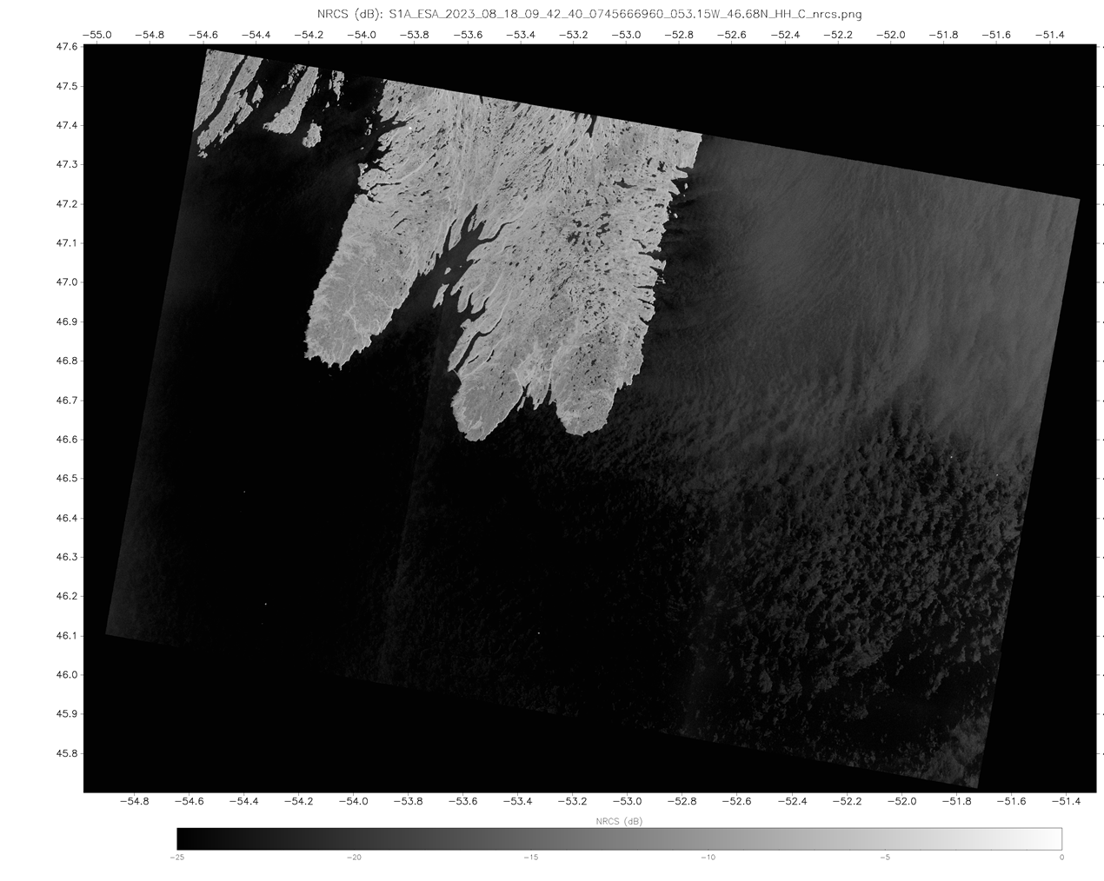
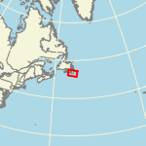
The effect of wind…
Sentinel 1A SAR Co-Pol HH NRCS
18 August 2023 09:42 UTC
Wind
As the surface wind over the ocean increases, the radar backscatter increases
Bright = Rough
Dark = Smooth
No Wind
https://www.star.nesdis.noaa.gov/socd/mecb/sar/AKDEMO_products/APL_winds/wind_images2/2023-08/S1A_ESA_2023_08_18_09_42_40_0745666960_053.15W_46.68N_HH_C_nrcs.png

Slide 6
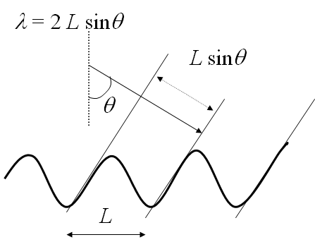
Components of ocean surface roughness contributing to backscatter
Wind is the principle source of ocean surface roughness for active microwave instruments
The wind generates short waves (capillary to short gravity waves) that have wavelengths from a few centimeters to tens of centimeters and periods < 1 second
As the wind over the ocean surface increases, the radar backscatter from the wind-driven short (cm scale) waves increases due to interaction between the incident radar wave and the short surface waves through a Bragg-like resonance.
All other atmospheric and oceanic phenomena visible on the ocean surface in a SAR image are the result of modifiying the pattern of the wind-generated short waves.

Slide 7
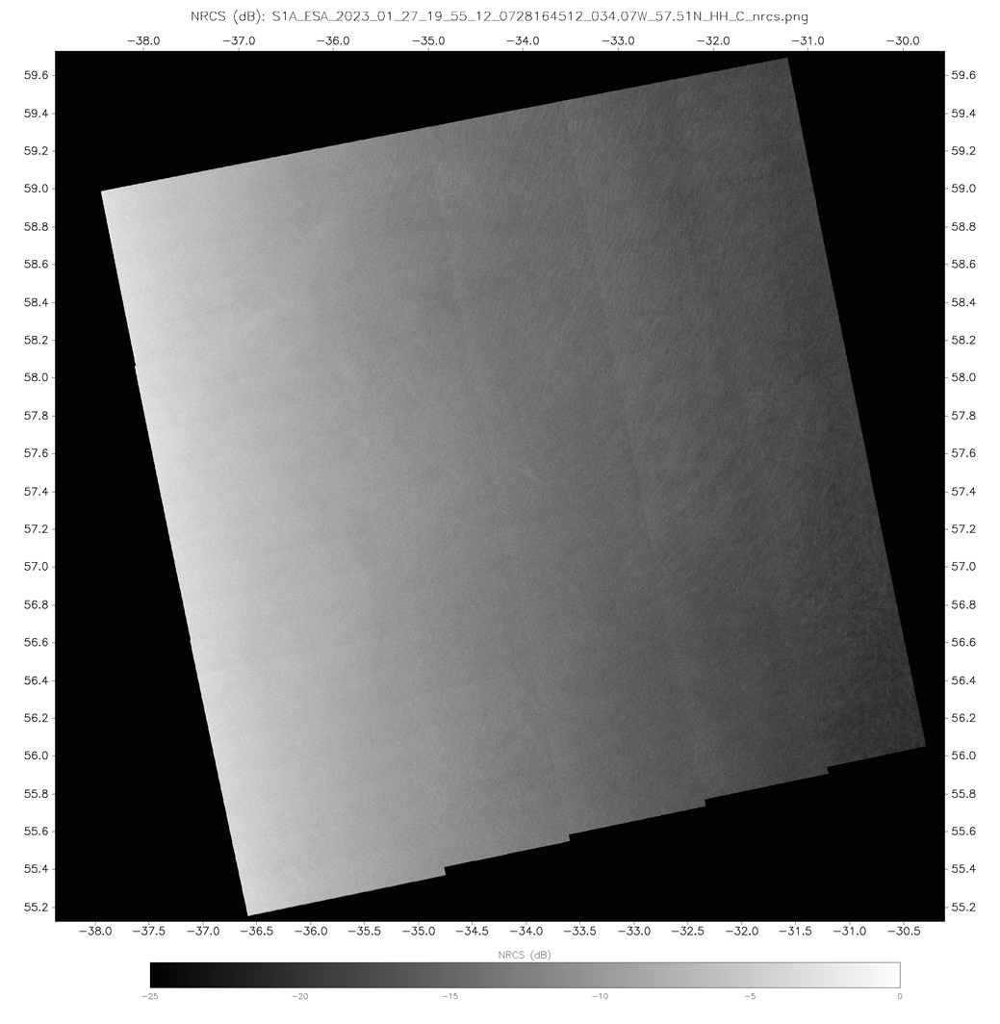
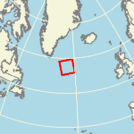
Information Content
Sentinel 1A SAR Co-Pol HH NRCS
27 January 2023 19:55 UTC
Even “non-descript” images…..
https://www.star.nesdis.noaa.gov/socd/mecb/sar/AKDEMO_products/APL_winds/wind_images2/2023-01/S1A_ESA_2023_01_27_19_55_12_0728164512_034.07W_57.51N_HH_C_nrcs.png

Slide 8
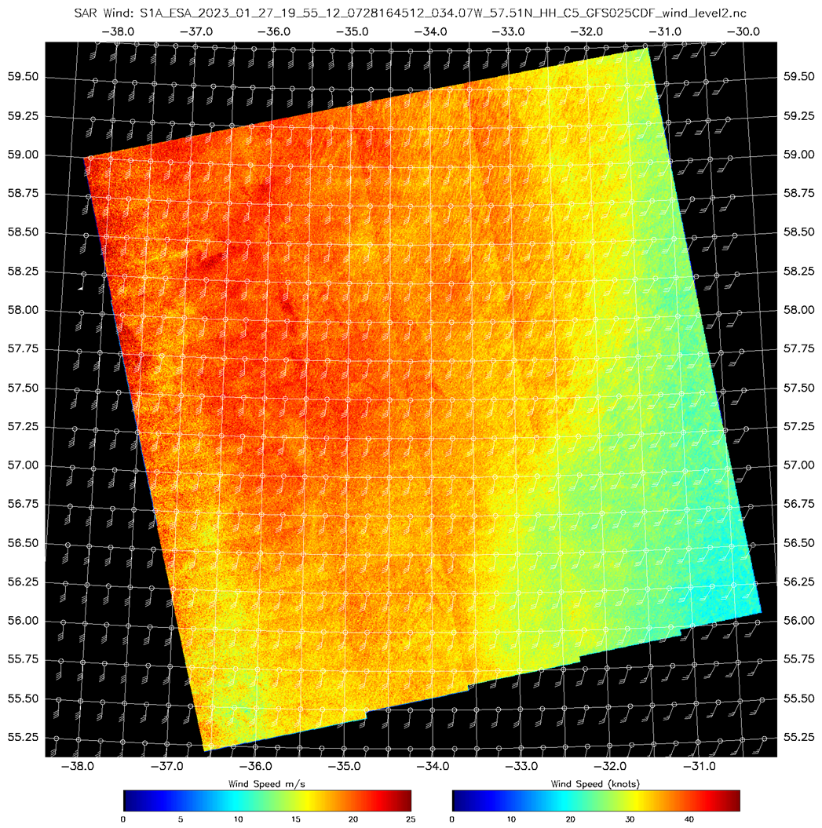
SAR Derived Wind Speed
Sentinel 1A SAR Co-Pol HH NRCS
27 January 2023 19:55 UTC
Even “non-descript” images…..
… can contain useful information
Ocean surface Normalized Radar Cross Section converted to wind speed using the CMOD4 Geophysical Model Function
https://www.star.nesdis.noaa.gov/socd/mecb/sar/AKDEMO_products/APL_winds/wind_images2/2023-01/S1A_ESA_2023_01_27_19_55_12_0728164512_034.07W_57.51N_HH_C5_GFS025CDF_wind.png

Slide 9
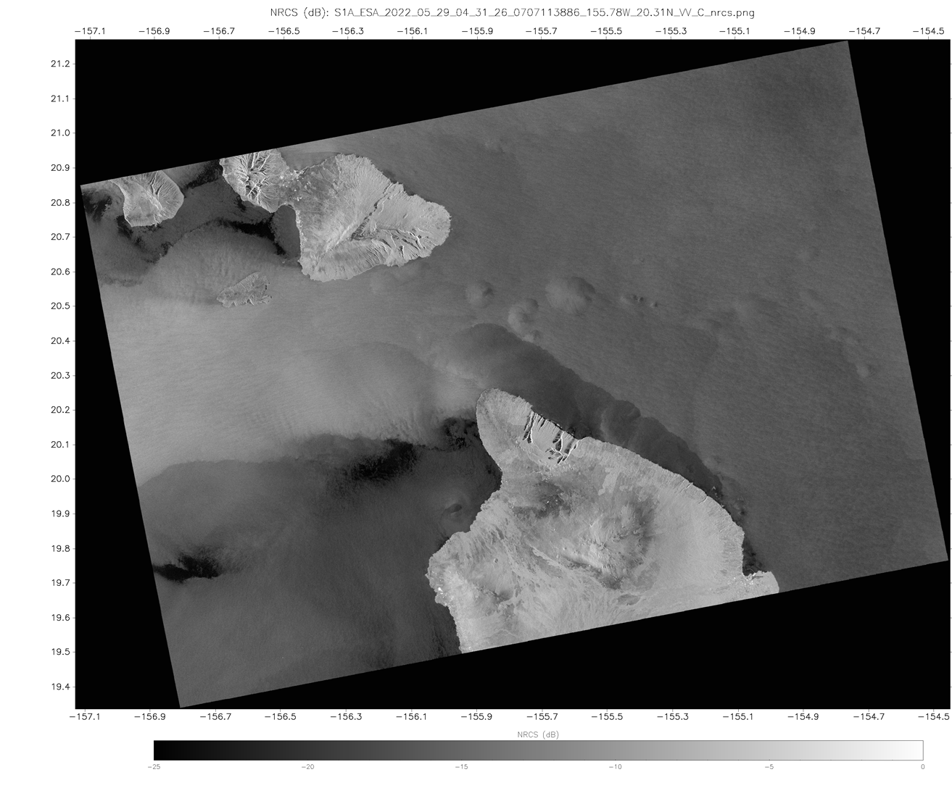
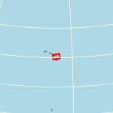
Atmosphere
Sentinel 1A SAR Co-Pol VV NRCS
29 May 2022 04:31 UTC
Moderate (15 kt) winds out of the east are influenced by the island topography producing regions of increased and reduced wind speed
Storm cell imprints (cold pools)
A cold pool is a pocket of dense air that forms when rain evaporates during intense precipitation. A surface-based cold pool is a region of relatively stable air.
Funneling
(increased wind speed)
Storm Cell Imprints
Shadowing
(decreased wind speed)
https://www.star.nesdis.noaa.gov/socd/mecb/sar/AKDEMO_products/APL_winds/wind_images2/2022-05/S1A_ESA_2022_05_29_04_31_26_0707113886_155.78W_20.31N_VV_C_nrcs.png

Slide 10
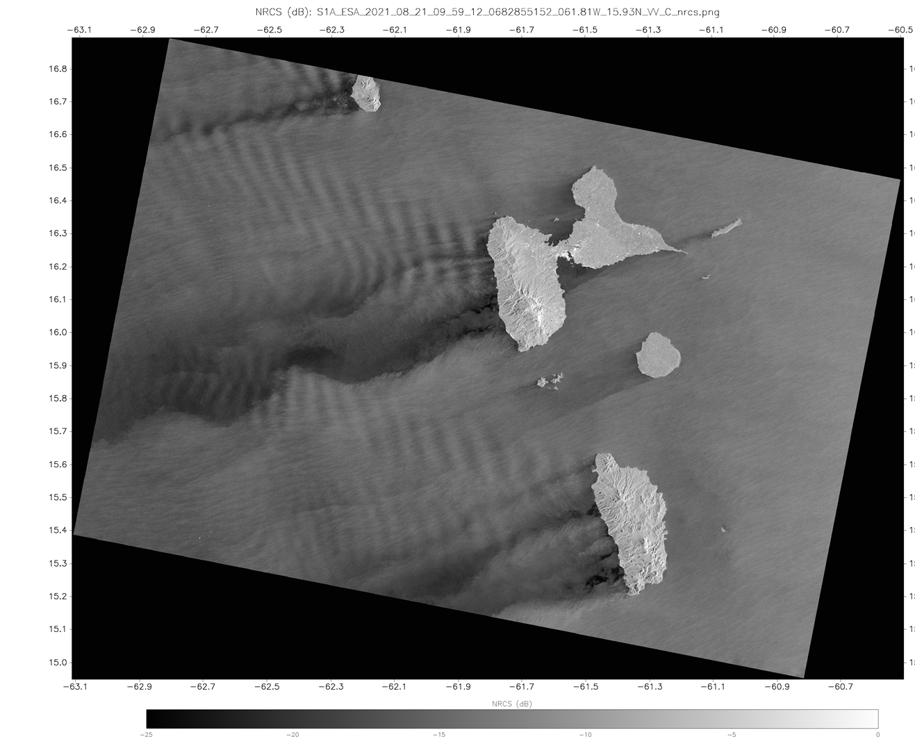
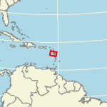
Atmosphere
Windward Islands
Sentinel 1A SAR Co-Pol Winds
21 August 2021 09:59 UTC
Wakes
Wind (from the east) interacting with the Windward Islands produce the signatures of wind funneling, island wakes.
Island wakes / shadowing can extend 100s of km behind an island
Funneling
Wakes
https://www.star.nesdis.noaa.gov/socd/mecb/sar/AKDEMO_products/APL_winds/wind_images2/2021-08/S1A_ESA_2021_08_21_09_59_12_0682855152_061.81W_15.93N_VV_C_nrcs.png

Slide 11
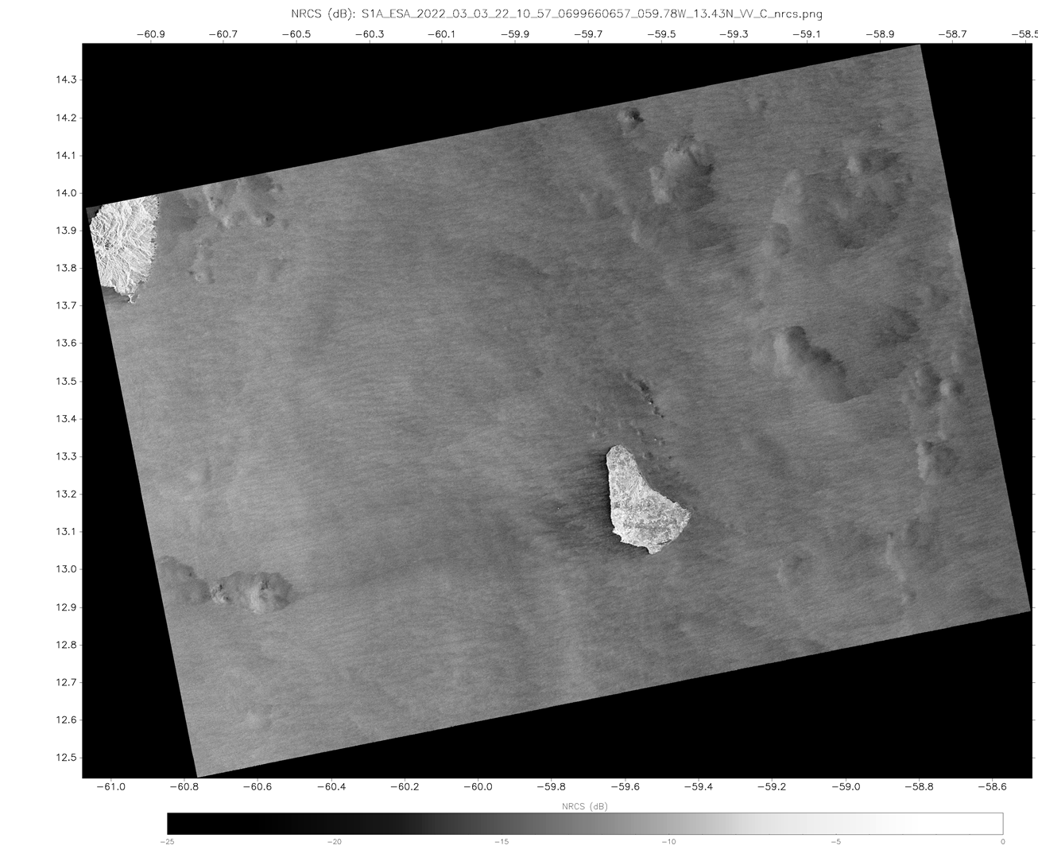
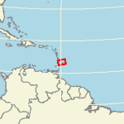
Atmosphere
Sentinel 1A SAR Co-Pol Winds
03 March 2022 22:11 UTC
Cold Pools
Atmospheric signatures include a gust front, cold pools, micro-cold pools and fine scale atmospheric boundary layer rolls (BLR)
BLRs are counterrotating vortical rolls along a horizontal axis that is approximately aligned with the mean wind direction.
Roll features
Micro-cold pools
Gust fronts
Cold Pools
Roll features
https://www.star.nesdis.noaa.gov/socd/mecb/sar/AKDEMO_products/APL_winds/wind_images2/2022-03/S1A_ESA_2022_03_03_22_10_57_0699660657_059.78W_13.43N_VV_C_nrcs.png

Slide 12
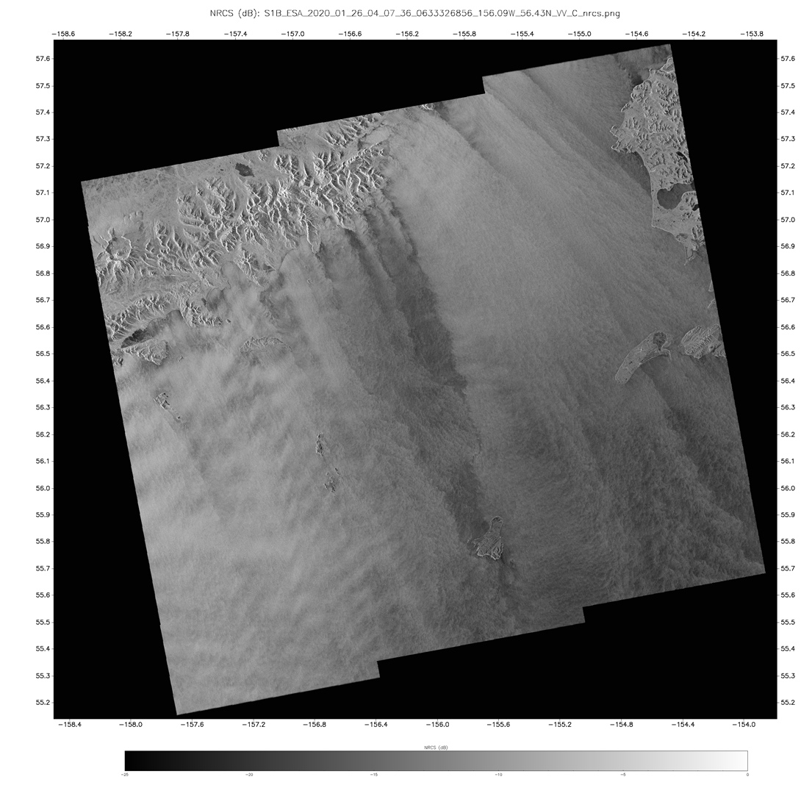
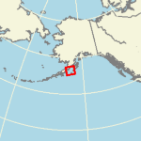
Atmosphere - Wind
Sentinel 1A SAR Co Pol VV NRCS
26 January 2020 04:07 UTC
Wind Streaks
15 to 20 kt winds out of the northwest are accelerated by gaps in the topography resulting in gap flows.
The flows produce “wind streaks” long linear features aligned with the wind direction
The topography has also induced lee waves (which appear as alternating light/dark bands parallel with the topography)
Lee Wave Imprint
https://www.star.nesdis.noaa.gov/socd/mecb/sar/AKDEMO_products/APL_winds/wind_images2/2020-01/S1B_ESA_2020_01_26_04_07_36_0633326856_156.09W_56.43N_VV_C_nrcs.png
https://www.star.nesdis.noaa.gov/socd/mecb/sar/AKDEMO_products/APL_winds/wind_images2/2020-01/S1B_ESA_2020_01_26_04_07_36_0633326856_156.09W_56.43N_VV_C5_GFS05CDF_wind.png

Slide 13
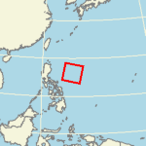
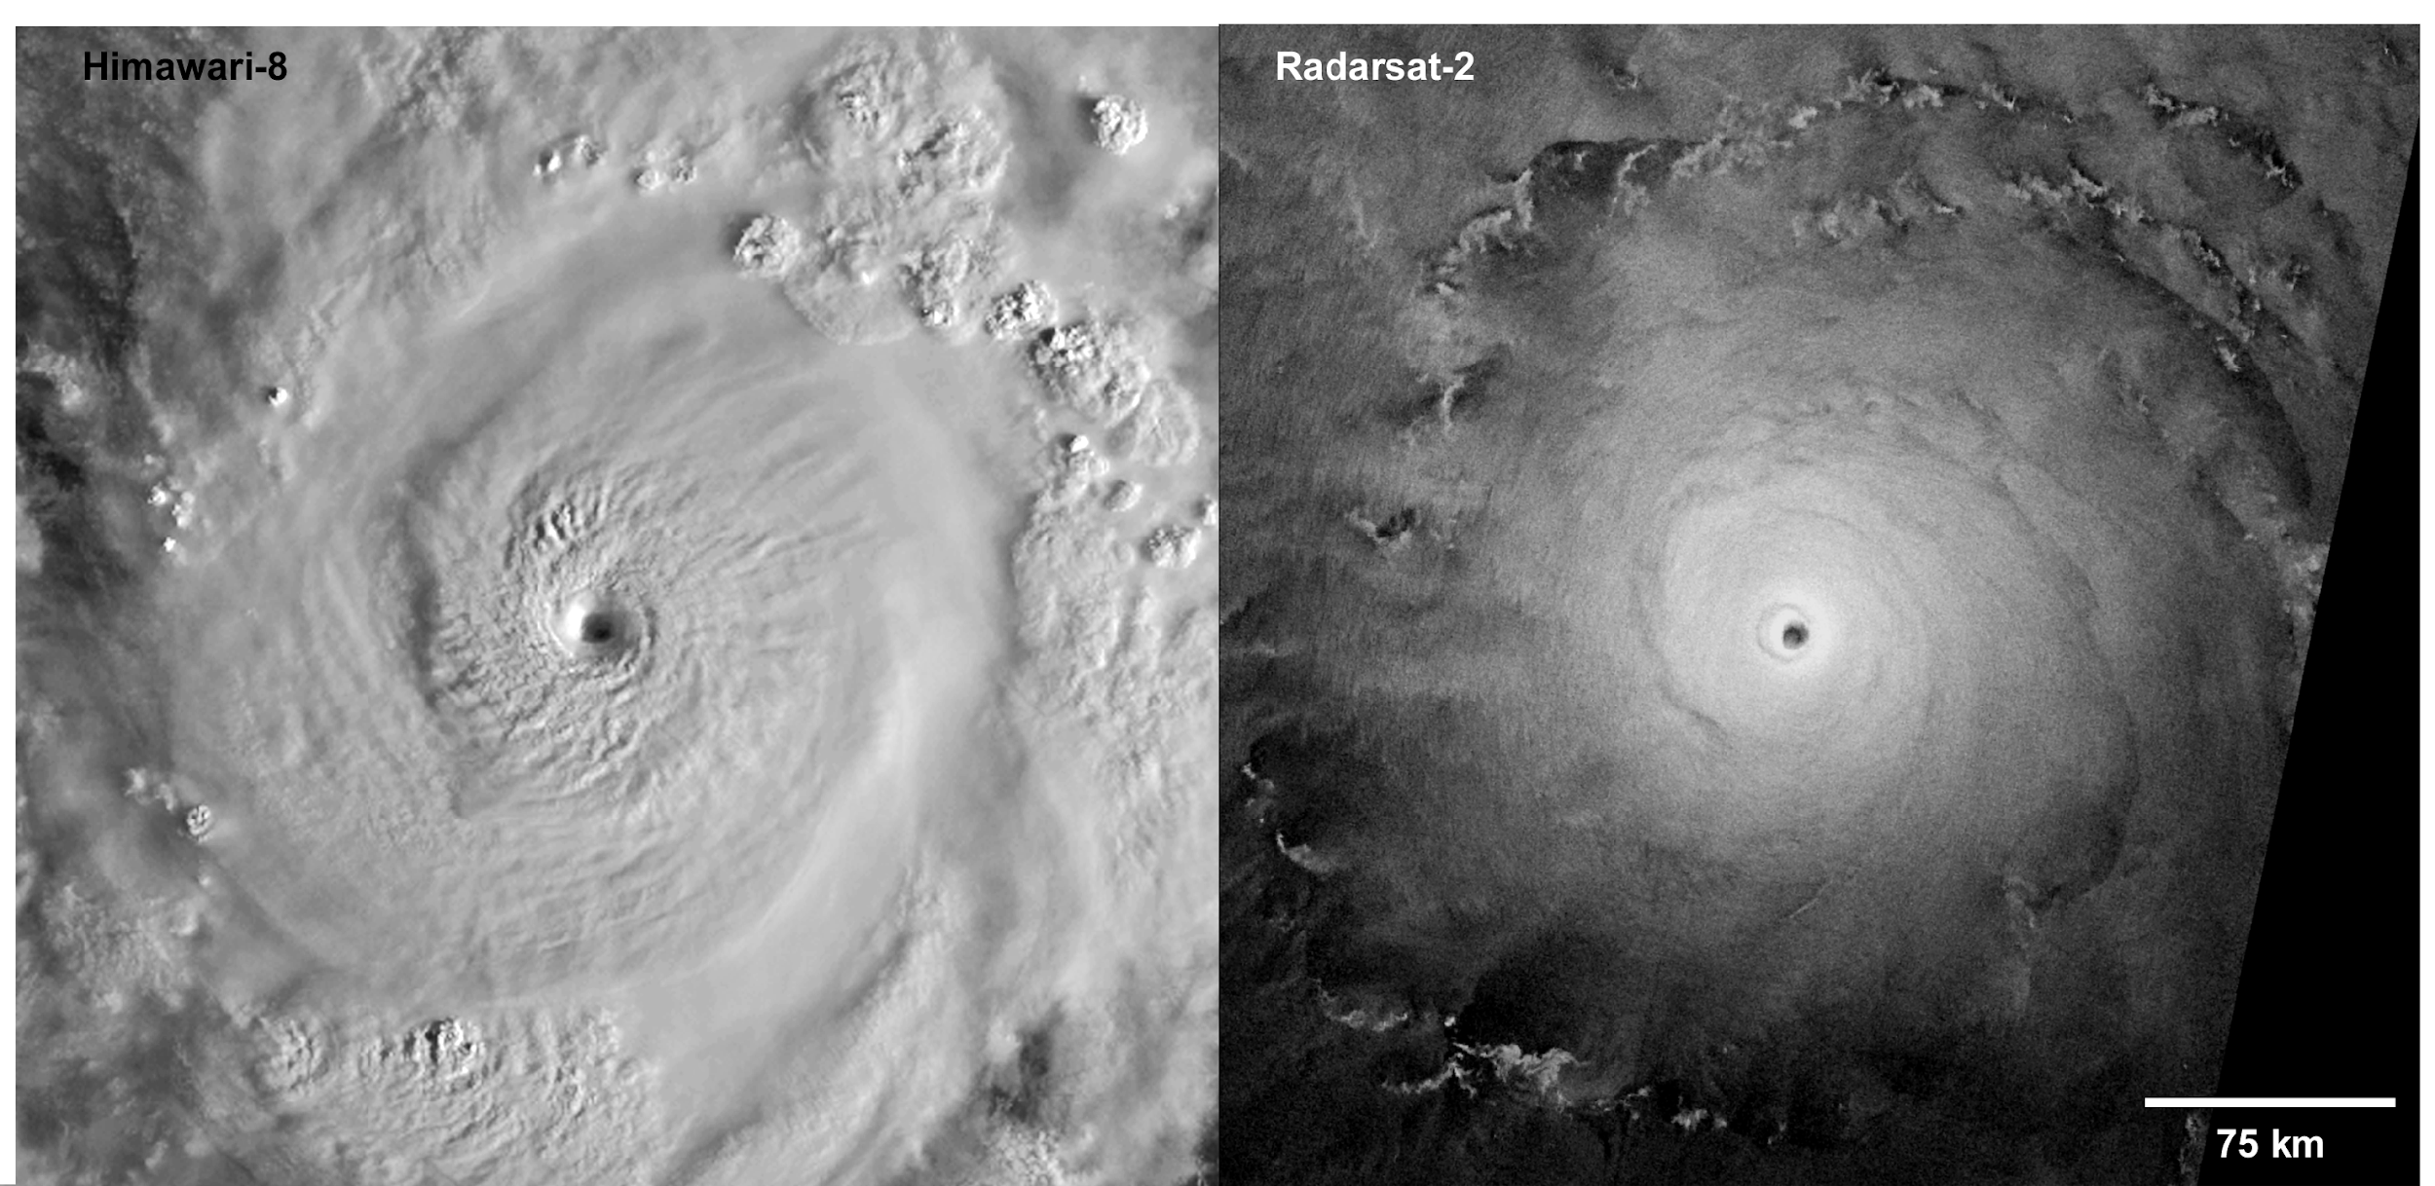
Super Typhoon Goni – 30 Oct 2020
Himawari-8 22:17 UTC Visible Band
(Cloud Top)
Radarsat-2 21:16 UTC Cross-Polarization (VH)
(Ocean Surface)
https://www.star.nesdis.noaa.gov/socd/mecb/sar/sarwinds_tropical.php?year=2020&storm=WP222020_GONI
Notes:
Fig. 1. These two satellite images of Super Typhoon Goni over the Pacific Ocean were taken at almost the same time on 30 October 2020, when the storm was close to peak intensity with wind speeds exceeding 155 knots. The visible-light image from Japan’s Himawari-8 satellite (left; 500-meter resolution) captures the reflection of sunlight from the cloud tops and shows transverse bands in the cirrus clouds, a sloping eyewall, spiral banding features circling more than 360°, and a clear eye (indicative of an intense tropical cyclone). The wide-swath SAR image acquired by the Radarsat-2 satellite (right; with 100-meter resolution) shows the radar backscatter return from the ocean surface and patterns from convection cells, rainbands, and outflow boundaries, along with spiral wind streaks.

Slide 14
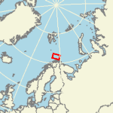
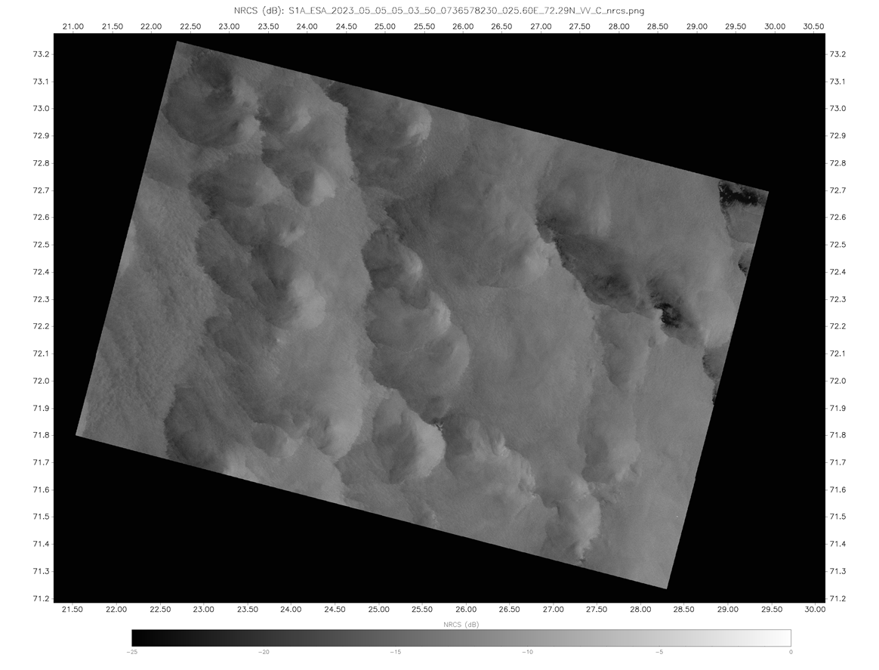
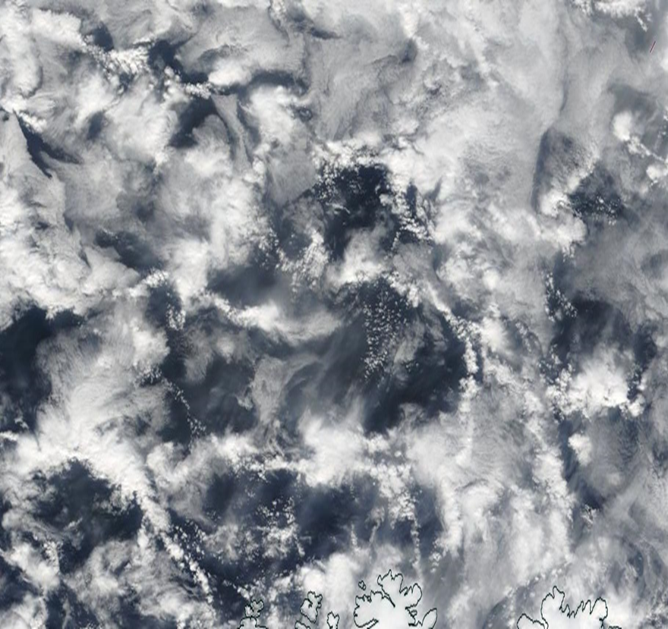
Atmosphere - Open Cell Clouds
MODIS True Color
05 May 2023 04:45 UTC
Sentinel-1 SAR VV Co-Pol NRCS
05 May 2023 05:03 UTC
https://www.star.nesdis.noaa.gov/socd/mecb/sar/AKDEMO_products/APL_winds/wind_images2/2023-05/S1A_ESA_2023_05_05_05_03_50_0736578230_025.60E_72.29N_VV_C_nrcs.png

Slide 15
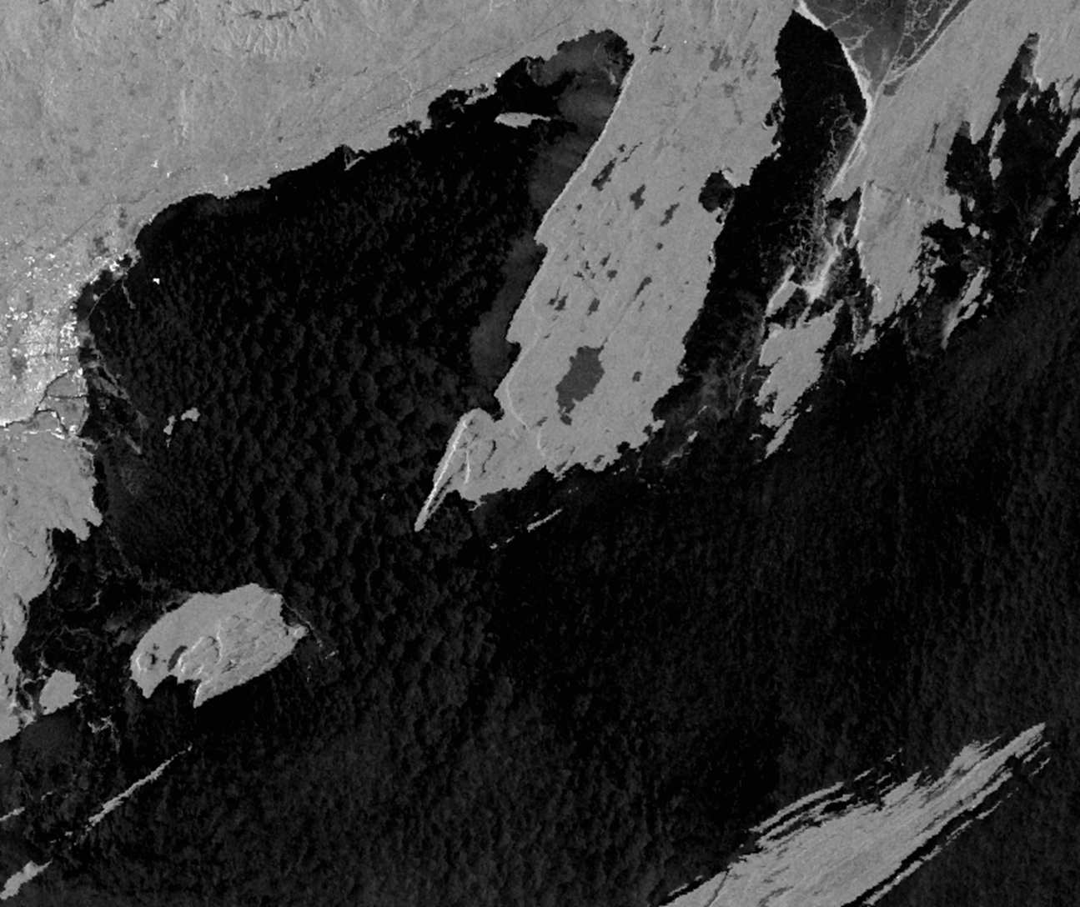
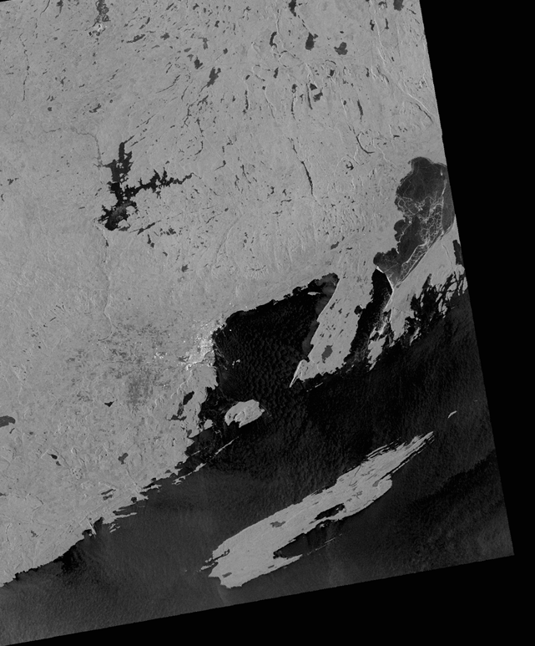
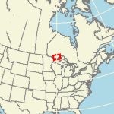
Atmosphere - Convection Cells
10 km
Thunder Bay – Lake Superior
Sentinel-1B 22 December 2021 23:50 UTC
https://www.star.nesdis.noaa.gov/socd/mecb/sar/AKDEMO_products/APL_winds/wind_images2/2021-12/S1B_ESA_2021_12_22_23_50_30_0693532230_089.95W_48.46N_VV_C_nrcs.png

Slide 16
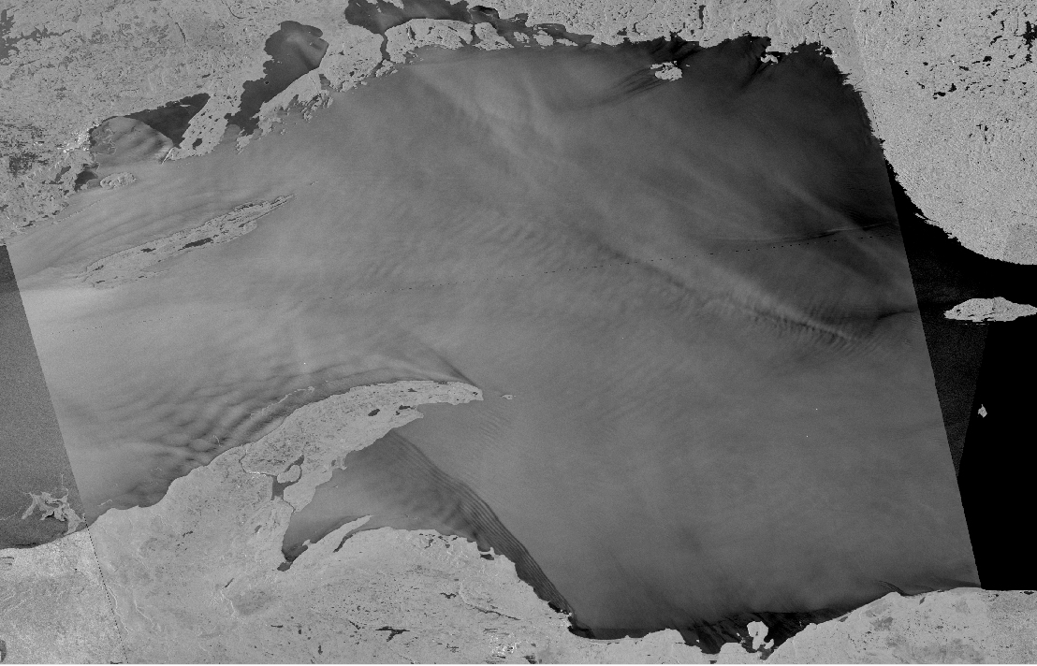
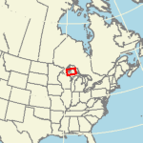
Atmosphere – Lee waves and Atmospheric Gravity Waves
Sentinel-1 SAR
VV Co-Pol NRCS
22 April 2022 23:42 UTC
Lee Wave
Atmospheric Gravity Wave
Lee waves and atmospheric gravity waves
https://www.star.nesdis.noaa.gov/socd/mecb/sar/AKDEMO_products/APL_winds/wind_images2/2022-04/S1A_ESA_2022_04_22_23_42_35_0703986155_087.61W_47.10N_VV_C_nrcs.png
20 km

Slide 17
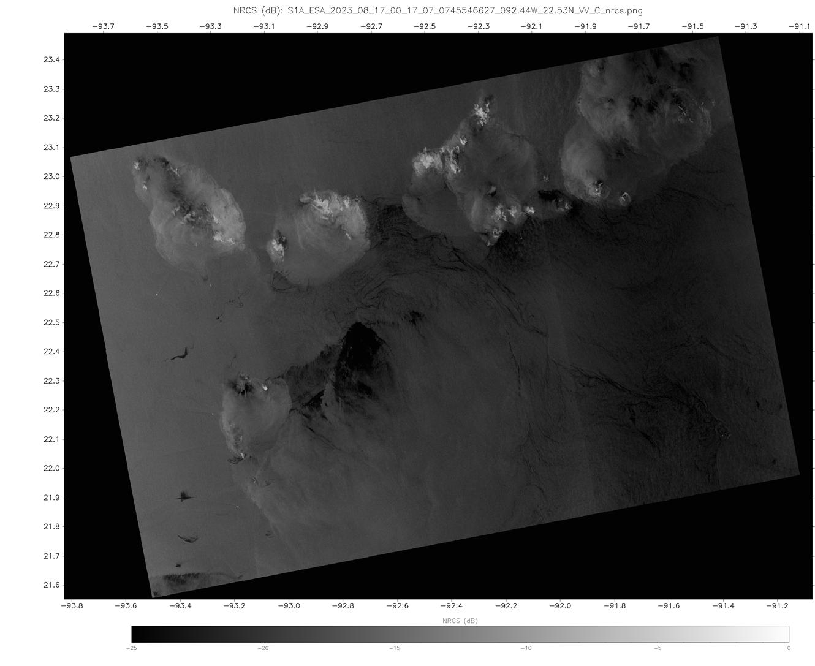
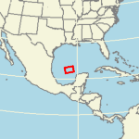
Atmosphere and Ocean
Sentinel 1A SAR Co-Pol Winds
17 August 2023 00:17 UTC
Storm Cells
w/ice signatures
Atmospheric signatures include storm cells with high NRCS returns from atmospheric ice.
Low NRCS features are regions of low wind and natural surfactants (oil)
Low Wind
Surfactants
https://www.star.nesdis.noaa.gov/socd/mecb/sar/AKDEMO_products/APL_winds/wind_images2/2023-08/S1A_ESA_2023_08_17_00_17_07_0745546627_092.44W_22.53N_VV_C_nrcs.png

Slide 18
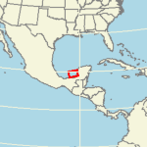
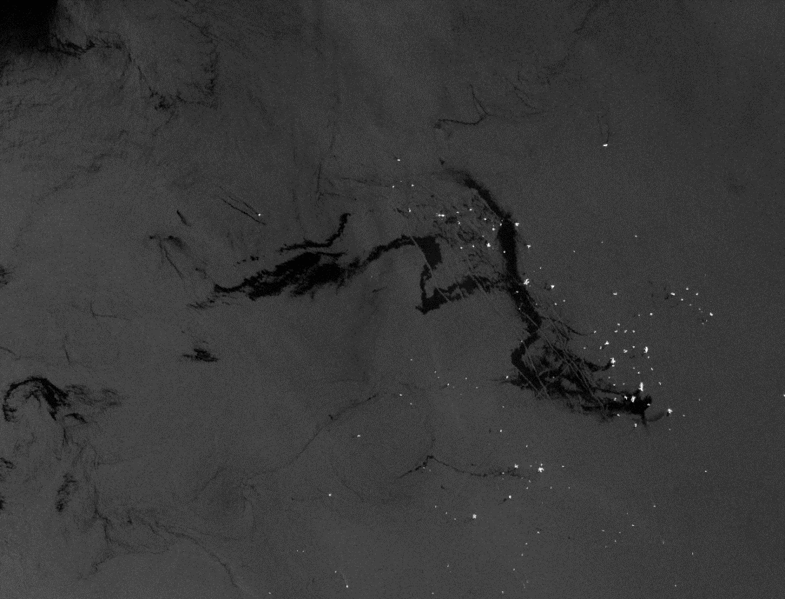
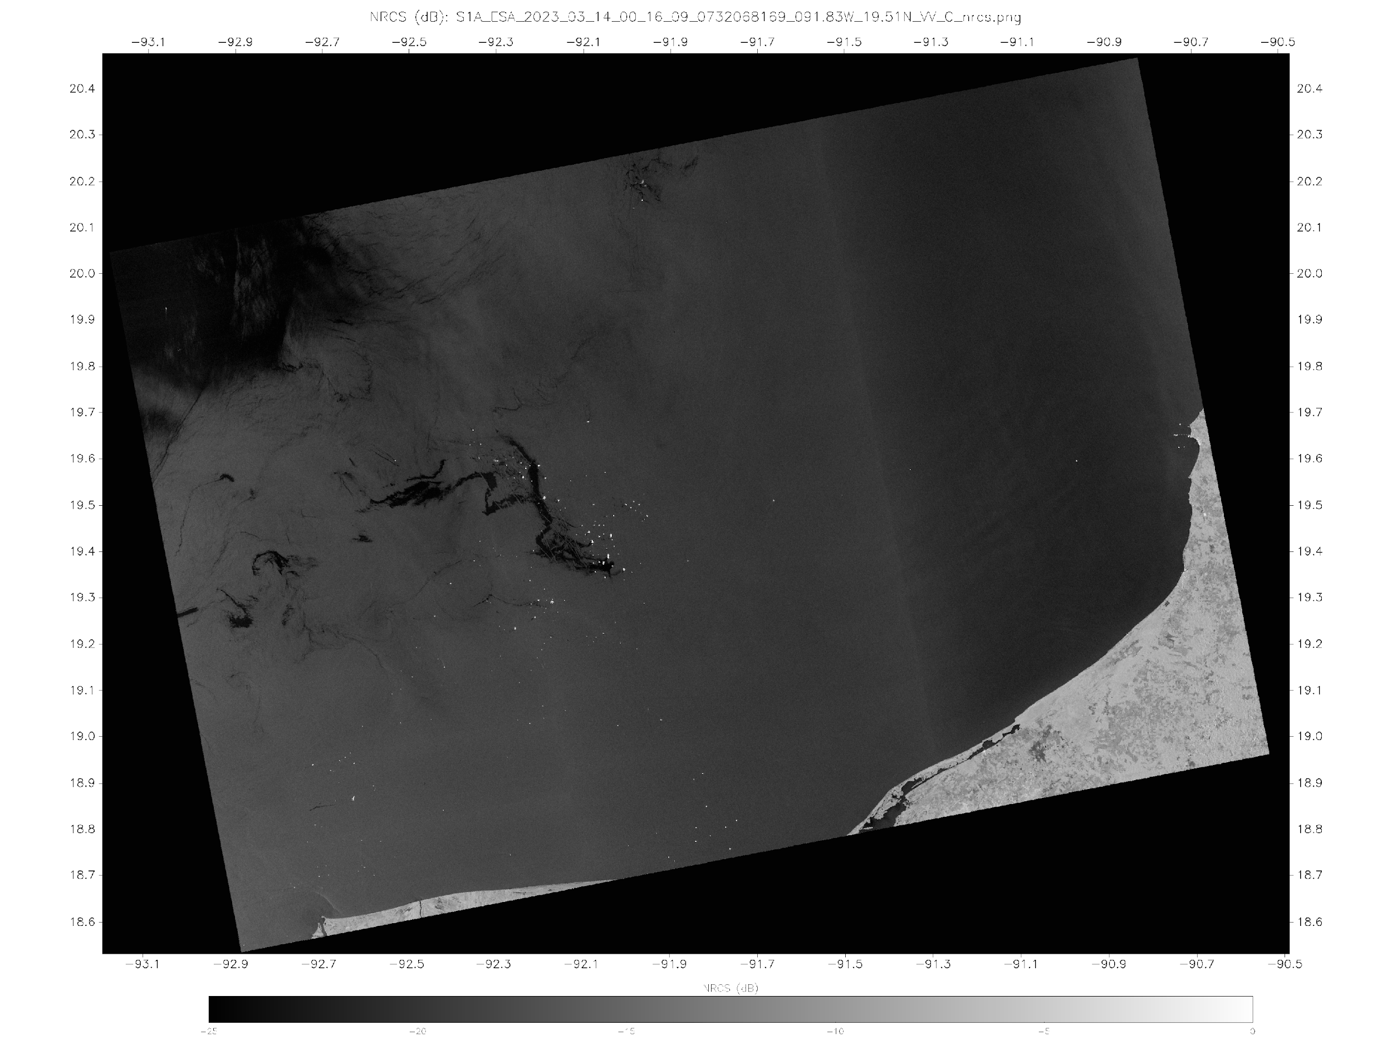
Ocean – Oil
Sentinel-1 SAR VV Co-Pol NRCS
14 March 2023 00:16 UTC
20 km
Ships and Oil Platforms (high backscatter)
Oil spill and surfactants (low backscatter)
https://www.star.nesdis.noaa.gov/socd/mecb/sar/AKDEMO_products/APL_winds/wind_images2/2023-03/S1A_ESA_2023_03_14_00_16_09_0732068169_091.83W_19.51N_VV_C_nrcs.png

Slide 19
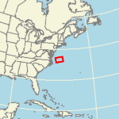
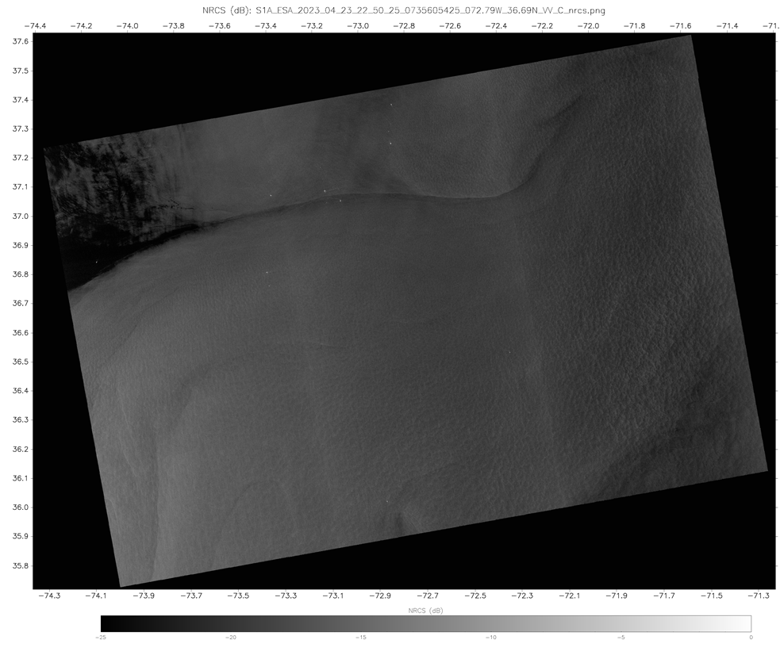
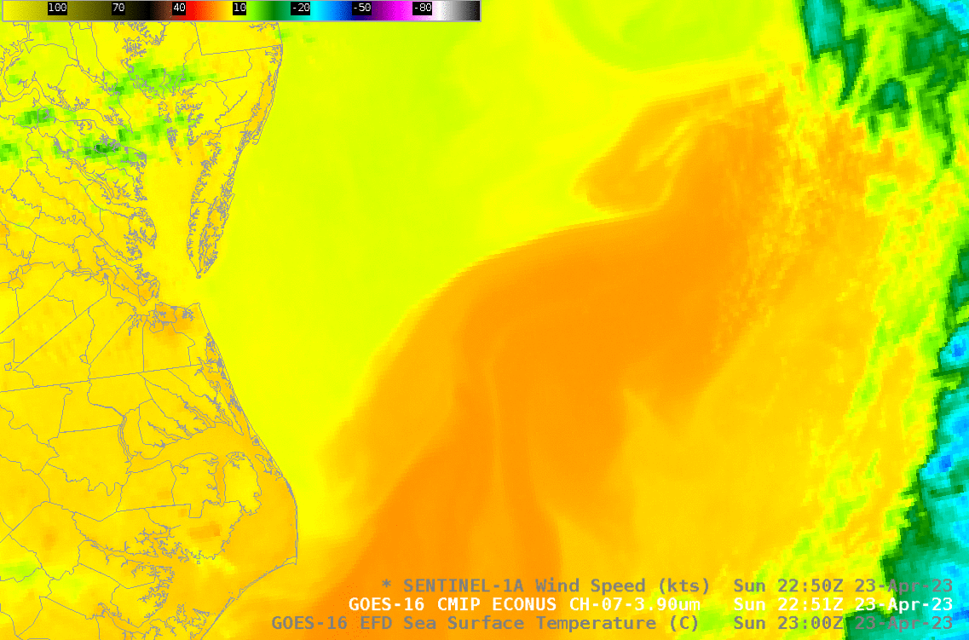
Ocean – Sea Surface Temperature (SST) on SAR Backscatter
Sentinel-1 SAR VV Co-Pol NRCS
23 April 2023 22:50 UTC
SAR data views of the North Wall of the Gulf Stream by Scott Lindstrom
https://cimss.ssec.wisc.edu/satellite-blog/archives/51902
Gulf Stream
North Wall
MABL Instability
Water temperature affects water surface tension, which influences the formation of wind driven capillary waves. Differences in the capillary wave field show up as difference in backscatter
MABL= Marine Atmospheric Boundary Layer
https://www.star.nesdis.noaa.gov/socd/mecb/sar/AKDEMO_products/APL_winds/wind_images2/2023-04/S1A_ESA_2023_04_23_22_50_25_0735605425_072.79W_36.69N_VV_C_nrcs.png

Slide 20
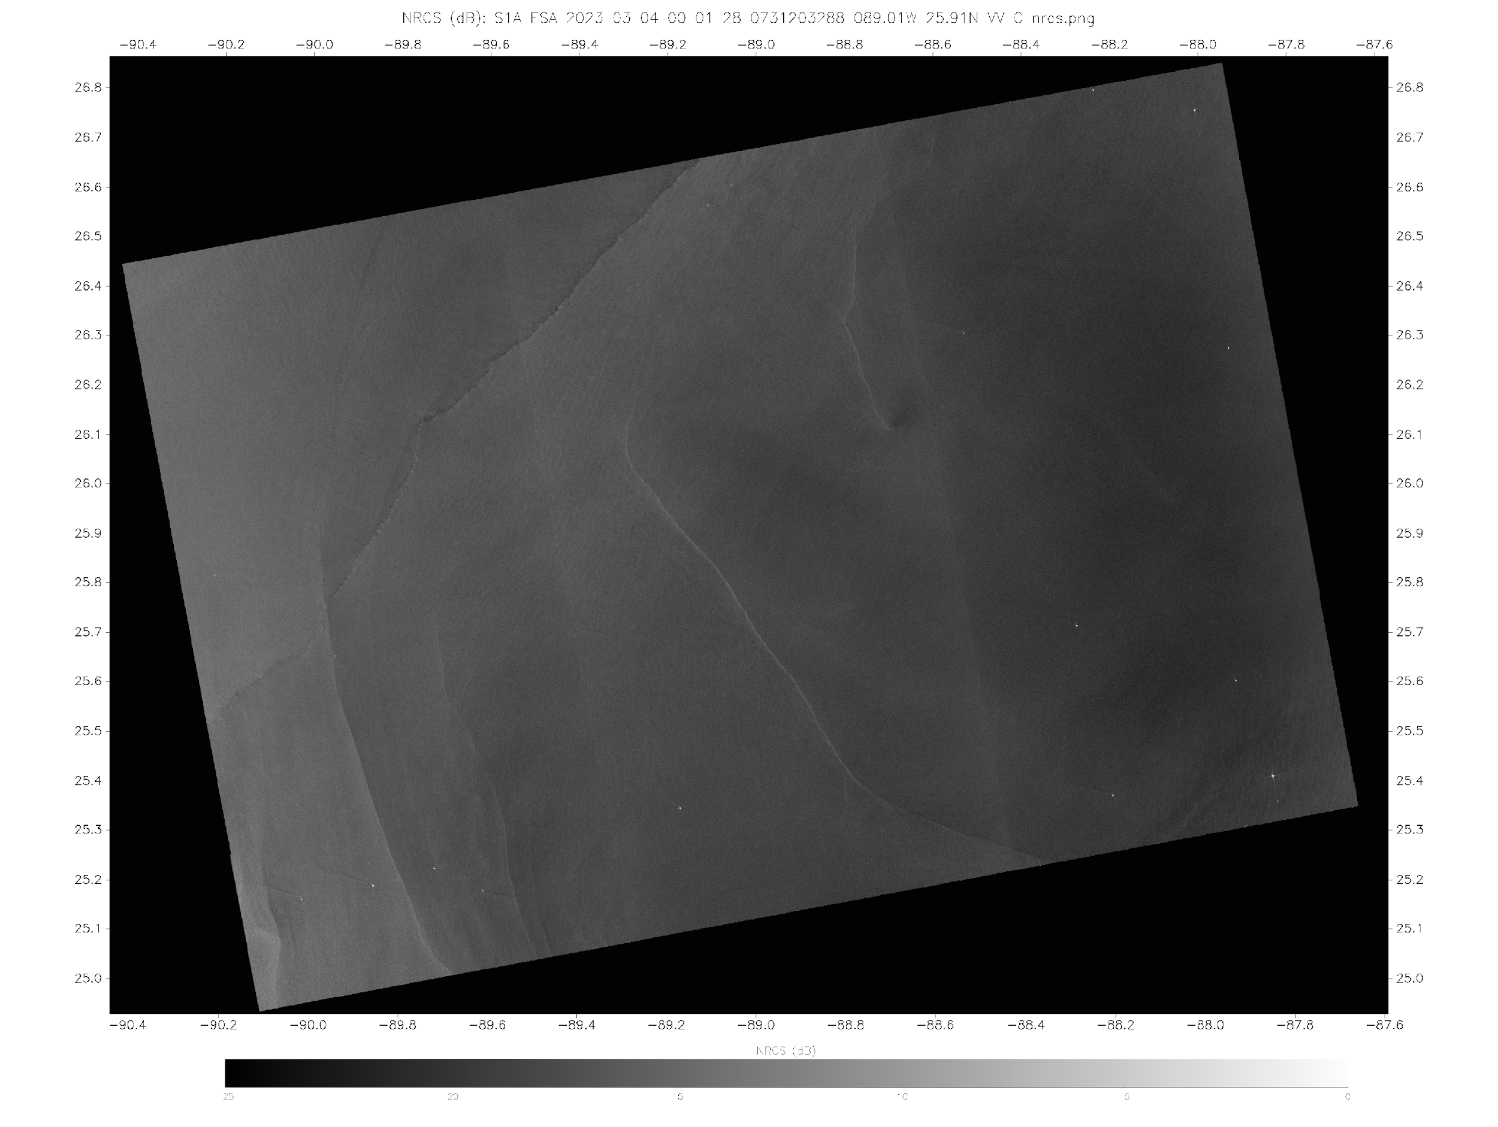
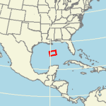
Ocean – Current / Suloy
Sentinel-1 SAR VV Co-Pol NRCS
4 March 2023 00:01 UTC
A Suloy is a line indicating an interface between two ocean currents.
At the interface, there is usually a slight upwelling altering the surface roughness
https://www.star.nesdis.noaa.gov/socd/mecb/sar/AKDEMO_products/APL_winds/wind_images2/2023-03/S1A_ESA_2023_03_04_00_01_28_0731203288_089.01W_25.91N_VV_C_nrcs.png

Slide 21
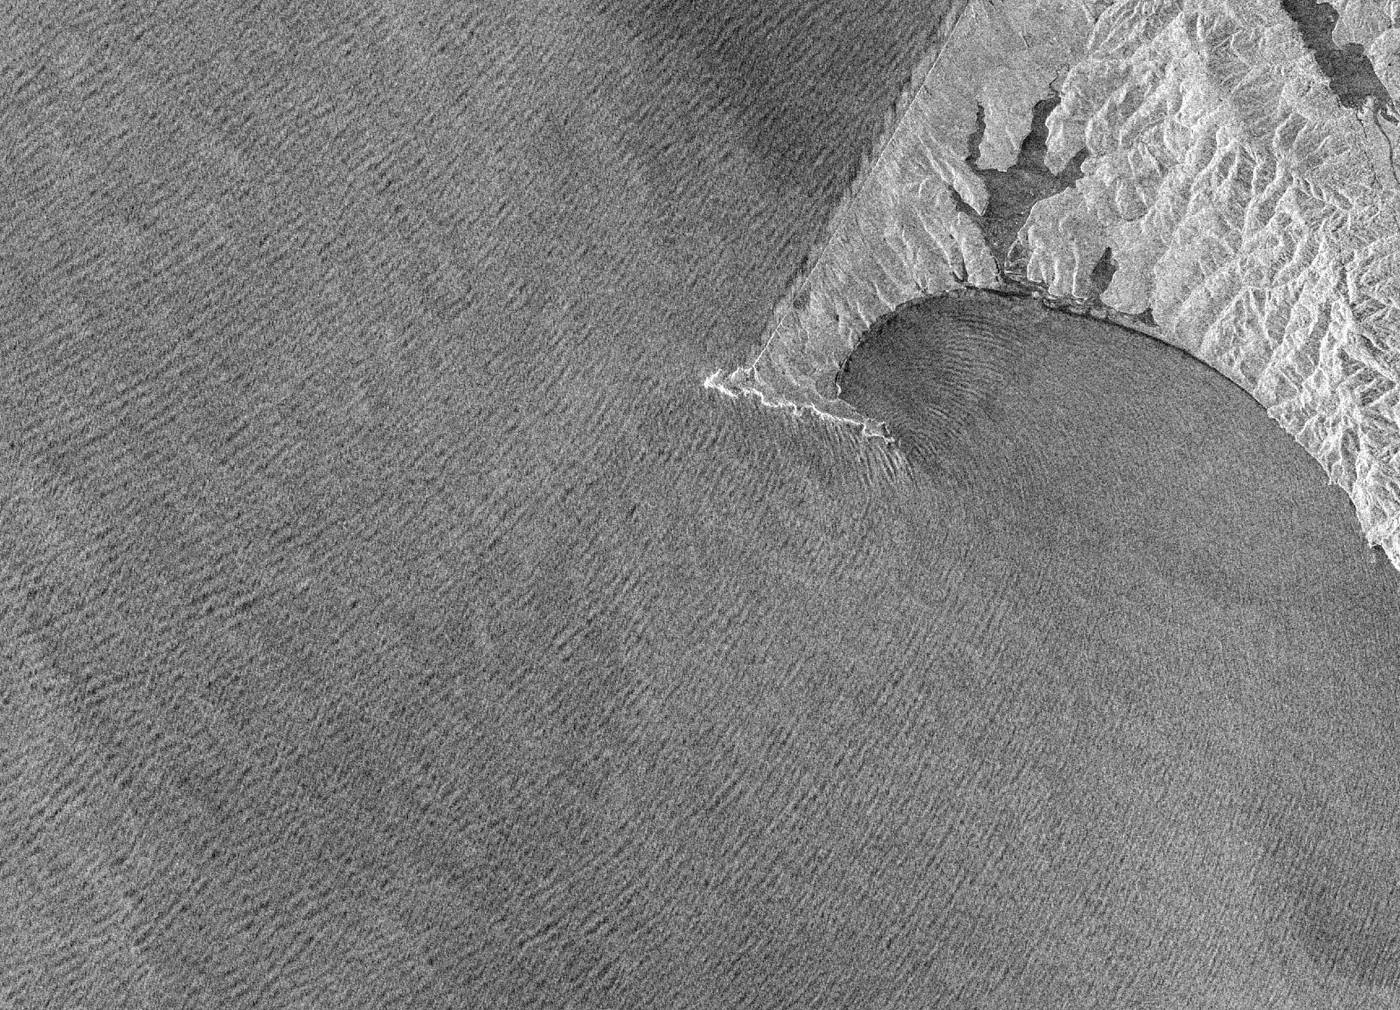
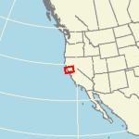
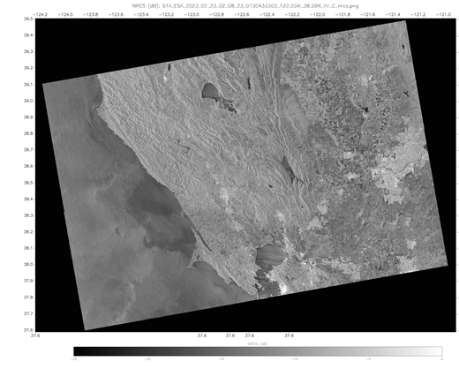
Ocean – Swell Waves
Sentinel-1 SAR VV Co-Pol NRCS
23 February 2023 02:08 UTC
Swell waves (wavelength ~400 m – 1km) are produced by consistent wind forcing.
The swell can be seen refracting around Point Reyes (California)
10 km
https://www.star.nesdis.noaa.gov/socd/mecb/sar/AKDEMO_products/APL_winds/wind_images2/2023-02/S1A_ESA_2023_02_23_02_08_23_0730433303_122.55W_38.56N_VV_C_nrcs.png

Slide 22
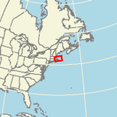
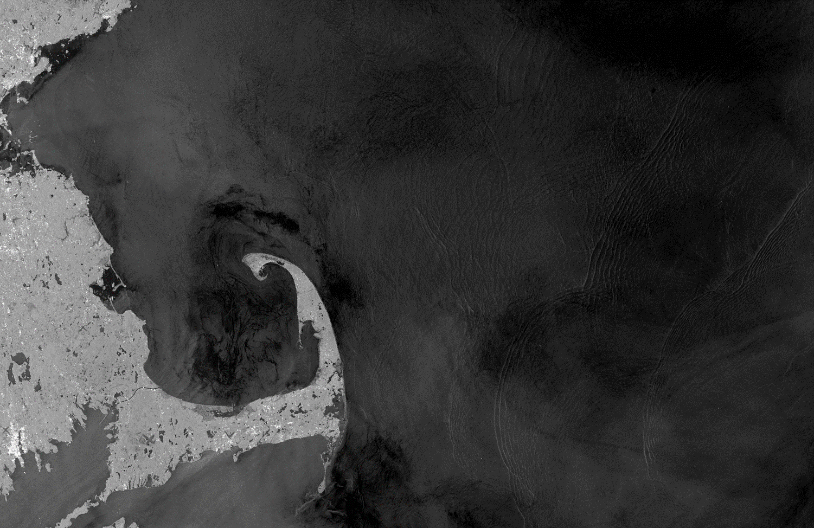
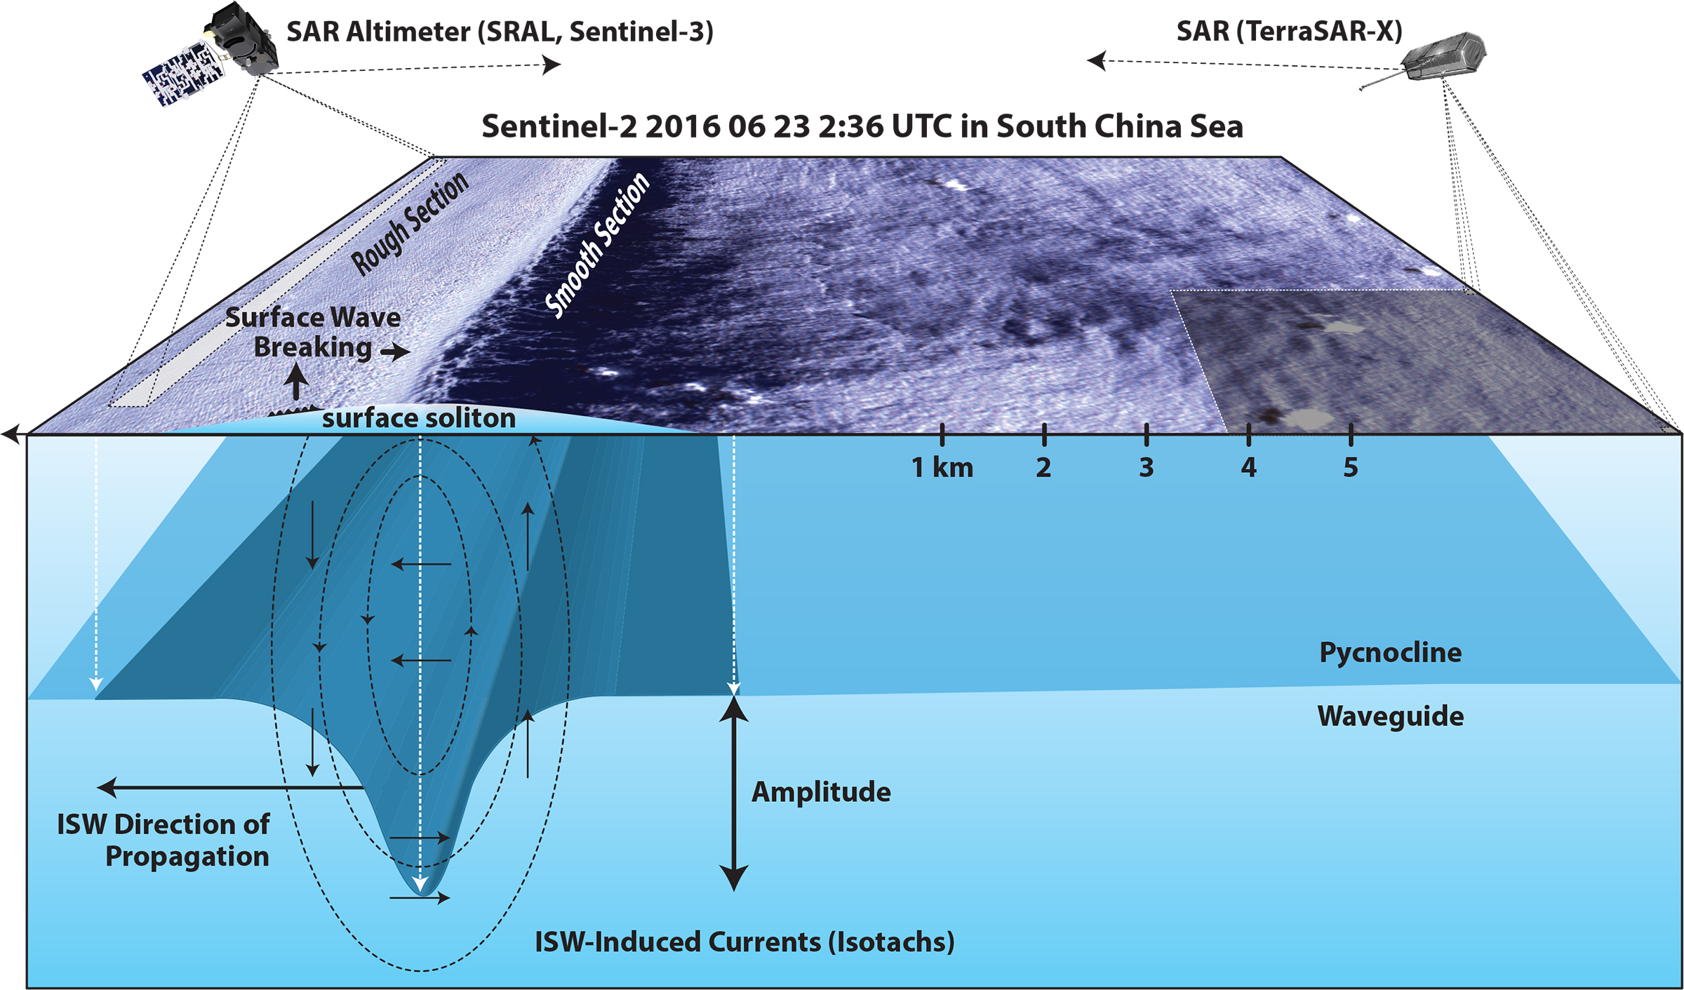
Ocean – Nonlinear Internal Waves
Sentinel-1 SAR VV Co-Pol NRCS
5 August 2024 22:35 UTC
A nonlinear internal wave propagates along a density interface (pycnoline) in the water column. It induces convergent and divergent currents on the surface which alters the roughness allowing it to be detected.
Wave Packet
Wave Packet
40 km
Magalhães, J.M., W. Alpers, A.M. Santos-Ferreira, and J.C.B. da Silva. 2021. Surface wave breaking caused by internal solitary waves: Effects on radar backscattering measured by SAR and radar altimeter. Oceanography 34(2):166–176, https://doi.org/10.5670/ oceanog.2021.203.
https://www.star.nesdis.noaa.gov/socd/mecb/sar/AKDEMO_products/APL_winds/wind_images2/2024-08/S1A_ESA_2024_08_05_22_35_29_0776212529_069.87W_42.03N_VV_C_nrcs.png

Slide 23
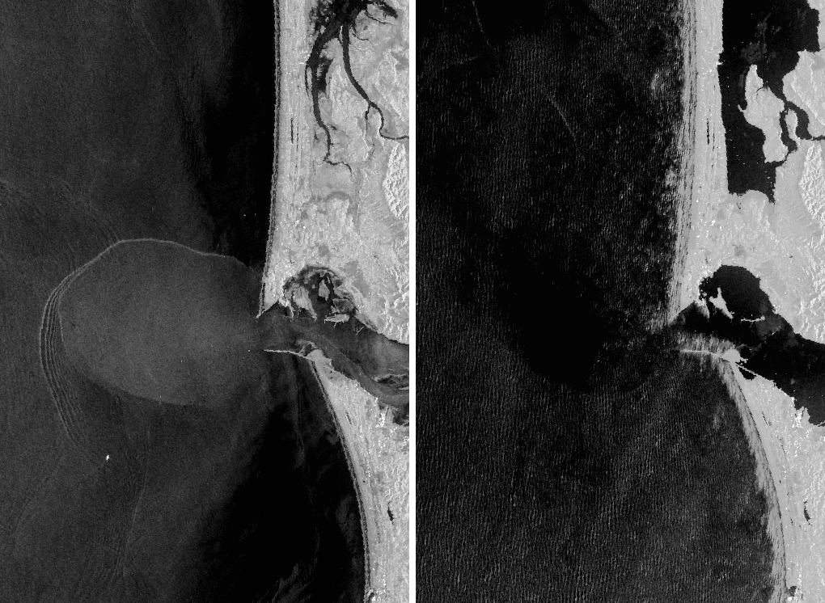
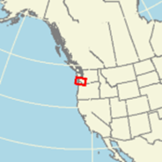
Ocean – River Plume and Wave Breaking
Sentinel-1 SAR VV Co-Pol NRCS
15 July 2023 14:22 UTC
Sentinel-1 SAR VV Co-Pol NRCS
6 December 2023 14:22 UTC
Breaking Waves
Pulses of warmer less dense water from river outflows create sharp boundary with ocean and have a reduced surface tension (and thus increased surface roughness)
Breaking waves affect (randomize) the phase of the radar pulses causing the resulting image to be “blurry”
River Plume
Breaking Waves
Internal Wave
Packet
10 km
Swell

Slide 24
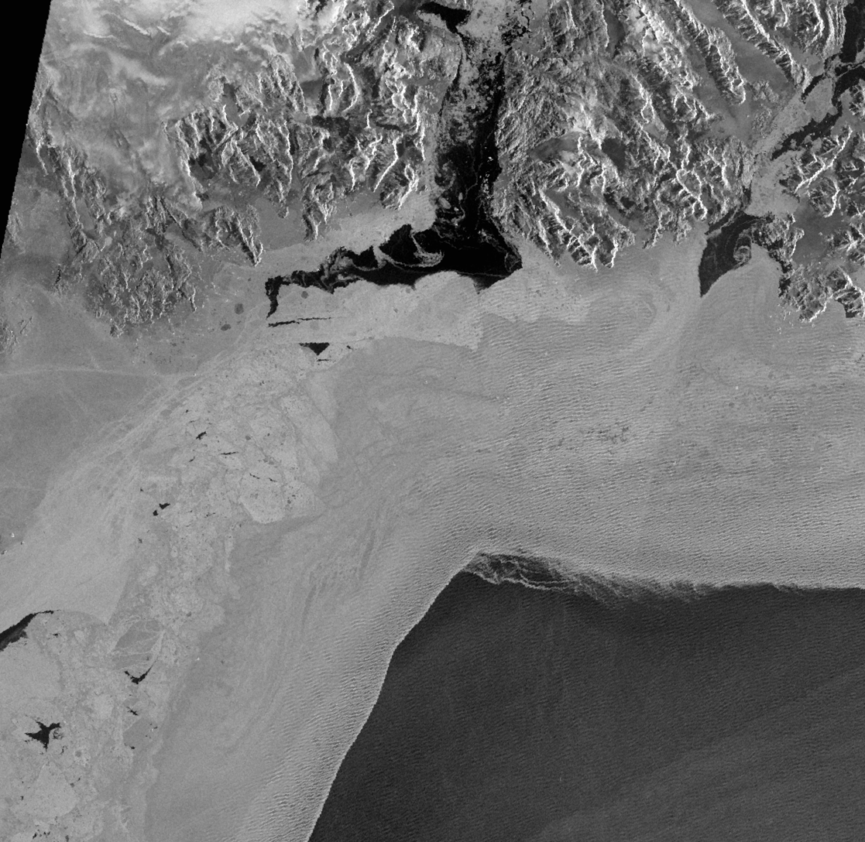
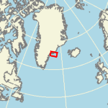
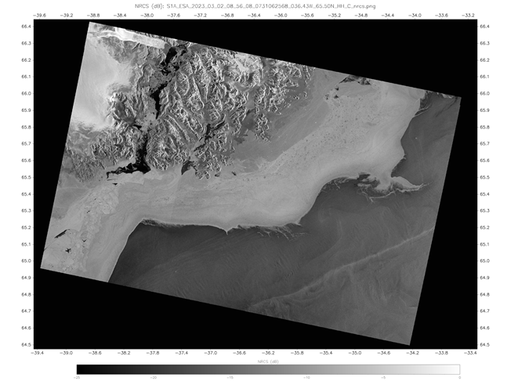
Ocean - Waves and Sea Ice
Sentinel-1 SAR HH Co-Pol NRCS
02 April 2023 22:50 UTC
Water
Young sea ice is thin enough to be influenced by oceanic currents and waves. Here it contains the imprint of the swell wave field propagating shoreward
Thin First Year Ice
Swell Waves
Young Ice
20 km
https://www.star.nesdis.noaa.gov/socd/mecb/sar/AKDEMO_products/APL_winds/wind_images2/2023-03/S1A_ESA_2023_03_02_08_56_08_0731062568_036.43W_65.50N_HH_C_nrcs.png

Slide 25
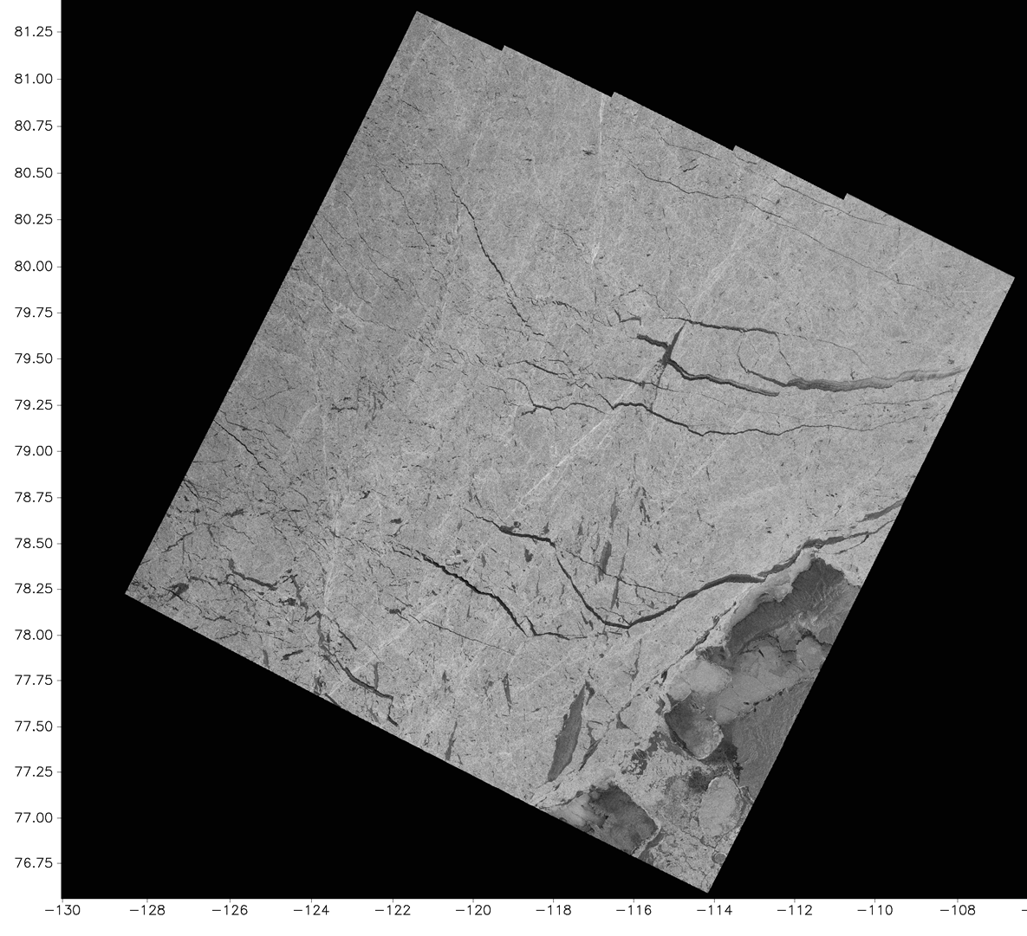
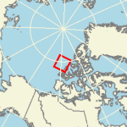
Ocean – Sea Ice
Sentinel-1 SAR HH Co-Pol NRCS
02 March 2023 15:27 UTC
Pressure Ridge
Leads
Multi-year ice pack ice off the Canadian Archipelago contains leads (breaks in the ice motion that exposes water) and pressure ridges (areas of sea ice compression).
Multi-year ice in winter is rough appearing bright, water is less rough (darker) and ridges have enhanced roughness (brighter)
Leads
Leads
https://www.star.nesdis.noaa.gov/socd/mecb/sar/AKDEMO_products/APL_winds/wind_images2/2023-03/S1A_ESA_2023_03_02_15_27_02_0731086022_117.75W_79.51N_HH_C_nrcs.png

Slide 26


Ocean – Sea Ice
Sentinel-1 SAR HH Co-Pol NRCS
23 October 2022 18:29 UTC
Thin First
Year Ice
Thick First
Year Ice
This image shows a variety of ice types in the Western Beaufort Sea as the sea ice begins to form and expand in the fall.
New ice is smooth and appears black
Young ice is influenced by the ocean currents
First year ice is riddled with breaks and leads.
Young Ice
New Ice
Water
https://www.star.nesdis.noaa.gov/socd/mecb/sar/AKDEMO_products/APL_winds/wind_images2/2022-10/S1A_ESA_2022_10_23_18_29_12_0719864952_169.95W_75.93N_HH_C_nrcs.png

Slide 27

Ocean – Sea Ice
Sentinel-1 SAR HH Co-Pol NRCS
24 August 2022 18:29 UTC
The sea ice edge in the Beaufort Sea looks very different after experiencing summer melt
https://www.star.nesdis.noaa.gov/socd/mecb/sar/AKDEMO_products/APL_winds/wind_images2/2022-08/S1A_ESA_2022_08_24_18_29_10_0714680950_169.96W_75.93N_HH_C_nrcs.png

Slide 28



Ocean - Lake Ice
See a True Color MODIS image from 31 Jan 2022
https://worldview.earthdata.nasa.gov/?v=-84.02631447225245,40.866,
-79.04768552774756,43.24900000000001&l=MODIS_Aqua_CorrectedReflectance_TrueColor&lg=true&t=2022-01-31-T22%3A37%3A51Z
Ice covering Lake Erie
Sentinel-1 SAR VV Co-Pol NRCS
30 January 2022 23:23 UTC
40 km
https://www.star.nesdis.noaa.gov/socd/mecb/sar/AKDEMO_products/APL_winds/wind_images2/2022-01/S1A_ESA_2022_01_30_23_24_38_0696900278_082.18W_41.77N_VV_C_nrcs.png

Slide 29

Ocean - Lake Ice
See a True Color MODIS image from 31 Jan 2022
https://worldview.earthdata.nasa.gov/?v=-84.02631447225245,40.866,
-79.04768552774756,43.24900000000001&l=MODIS_Aqua_CorrectedReflectance_TrueColor&lg=true&t=2022-01-31-T22%3A37%3A51Z
Ice covering Lake Erie
Sentinel-1 SAR VV Co-Pol NRCS
30 January 2022 23:23 UTC
40 km
https://www.star.nesdis.noaa.gov/socd/mecb/sar/AKDEMO_products/APL_winds/wind_images2/2022-01/S1A_ESA_2022_01_30_23_24_38_0696900278_082.18W_41.77N_VV_C_nrcs.png

Slide 30

Ocean - Lake Ice 30 January 2022
https://www.star.nesdis.noaa.gov/socd/mecb/sar/AKDEMO_products/APL_winds/wind_images2/2022-01/S1A_ESA_2022_01_30_23_24_38_0696900278_082.18W_41.77N_VV_C_nrcs.png
30 January 2022 23:23 UTC
Ship Tracks
Sentinel-1 SAR VV Co-Pol NRCS
30 January 2022 23:23 UTC
Ice covering Lake Erie
40 km

Slide 31


Ocean and Atmosphere
Sentinel-1 SAR VV Co-Pol NRCS
21 February 2023 00:39 UTC
And sometimes the image contain really complex collection of signatures…..
Current Boundaries
Atmospheric Front
Atmospheric Gravity Waves
Swell
Internal Waves
Surfactants
Ocean Vortices
These signatures are the result of interactions between surface winds, sea surface temperature, and ocean currents
https://www.star.nesdis.noaa.gov/socd/mecb/sar/AKDEMO_products/APL_winds/wind_images2/2023-02/S1A_ESA_2023_02_21_00_39_31_0730255171_097.04W_14.72N_VV_C_nrcs.png
https://www.star.nesdis.noaa.gov/socd/mecb/sar/AKDEMO_products/APL_winds/wind_images2/2023-02/S1A_ESA_2023_02_21_00_39_04_0730255144_096.71W_13.09N_VV_C_nrcs.png

Slide 32

Ocean and Atmosphere
Surfactants
Sentinel-1 SAR
VV Co-Pol NRCS
21 February 2023 00:39 UTC
Atmospheric Gravity Waves
Atmospheric Gravity Waves
Current Boundary
Ocean Vortices
Atmospheric Boundary
Surfactants
Current Boundary

Slide 33

References and other online sites for imagery and information
NOAA STAR SAR Ocean Surface Winds
Sentinel-1:
https://www.star.nesdis.noaa.gov/socd/mecb/sar/sarwinds_s1.php
Radarsat-2 and Radarsat Constellation Mission (RCM):
https://www.star.nesdis.noaa.gov/socd/mecb/sar/sarwinds_rcm_rs2.php
SAR Marine Users Manual (https://www.sarusersmanual.com)
Part I. Background
Part II. Oceanic Measurements
Part III. Atmospheric Boundary Layer Measurements
Part IV. Sea Ice Observations
ESA Ocean Virtual Laboratory (Sentinel-1)
https://ovl.oceandatalab.com
Cooperative Institute for Meteorological Satellite Studies (CIMSS)
Satellite Blog
https://cimss.ssec.wisc.edu/satellite-blog/

Slide 34

CoastWatch Data Portal
Contains Sentinel-1 100m NRCS PNG/NetCDF files since October 2018. The data are principally over the US EEZ (including Alaska and Hawaii) but also extend over the Caribbean and North Atlantic
Most of the imagery presented should be available.
Search L1/L2->S1A NRCS or S1B NRCS
https://coastwatch.noaa.gov/cw_html/cwViewer.html

